Slide 1

Pay-Per-Click Advertising

Slide 2
Elements of a Good Ad
Attention
Promise of Benefit
Credibility
Persuasiveness
Interest
Desire
Action

Slide 3
What Will Make You Stand Out?
Do you have the lowest price?
Do you have the best variety?
Do you have high-quality products?
What makes you credible?
How do you meet the needs of the potential buyer?

Slide 4
Focus on the Ad Title
Most people scan the title
Body copy holds less weight
Insert relevant keyword in the Title
  Google lets you do it automatically
If prices are low, put price in
Free add-ons can make a difference
  Free shipping
  Free 30 day trial

Slide 5
More Ad tips
Quantify your ads
  Most, Lowest
Avoid Using Hype
  Buyers are savvy
Create a Sense of Urgency
  "limited-time offer“
  "available for overnight shipping."
If you have space, add creditability
  30 day money back guarantee
  5 star rated vendor

Slide 6
Ad Tips
Look at Competitors
Create a unique approach that focuses on the opposite or reverse of what your competitors are advertising
Test, retest and track

Slide 7
Conversion - Landing Page
You just spent $$ to bring someone to your web site, now what?
Don’t waste it on your home page
Build specific landing pages that match the expectation your ad generated
Call to action – highlight your conversion
  - Buy
  - Download
  - Register

Slide 8
Landing Page
Call to action
Copy
Navigation – Limit, can distract
Merchandising
  Local, Geography, Season
Micro-site
  Self contained site just for the offer

Slide 9
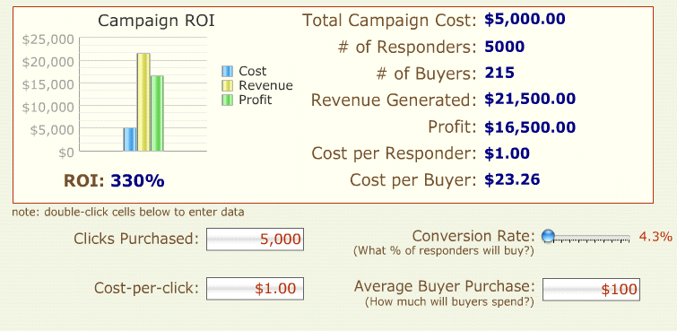
Improved Conversion

Slide 10
Google Adword
Google AdWords is the single most popular PPC advertising system in the world. The AdWords platform enables businesses to create ads that appear on Google’s search engine and other Google properties.
AdWords operates on a pay-per-click model, in which users bid on keywords and pay for each click on their advertisements.

Slide 11
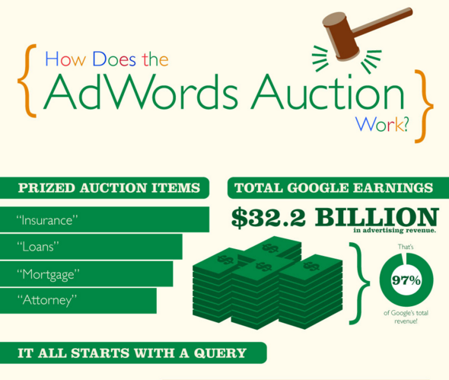

Slide 12
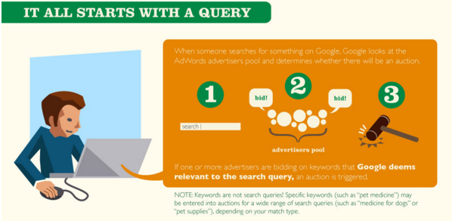

Slide 13
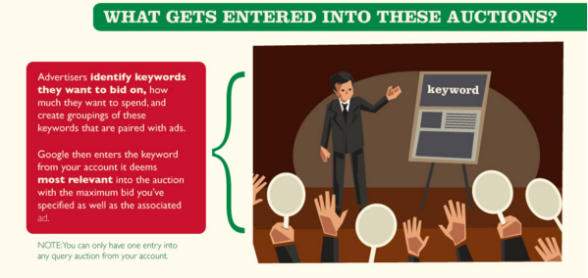

Slide 14
